Slide 1
Leverage Analysis
Presented by [Name]

Slide 2
Meaning and types of leverage
Leverage arises from the existence of fixed costs. There are two kinds of leverage, viz, operating leverage and financial leverage.
Operating leverage arises from the firm’s fixed operating costs such as salaries, rent, depreciation, insurance, property taxes, and advertising outlays.
Financial leverage arises from the firm’s fixed financing costs such as interest on debt

Slide 3
Types of Leverage
There are three commonly used measures of leverage in financial analysis. These are:
Operating Leverage: It is the relationship between Sales and EBIT and indicated business risk.
Financial Leverage: it is the relationship between EBIT and EPS and indicates financial risk.
Combined Leverage: It is the relationship between Sales and EPS and indicated total risk.

Slide 4
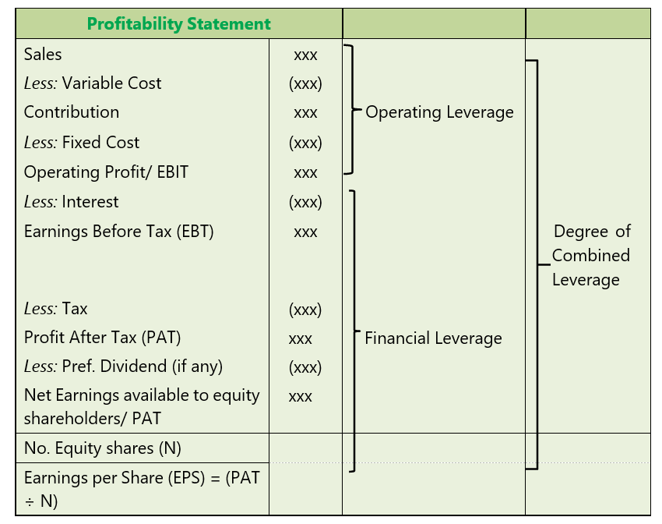
Operating Leverage, Financial Leverage and Combined leverage

Slide 5
Operating Leverage
Operating Leverage means tendency of operating income (EBIT) to change disproportionately with change in sale volume.
This disproportionate change is caused by operating fixed cost, which does not change with change in sales volume.
Operating leverage is a function of three factors:
Amount of fixed cost,
Variable contribution margin, and
Volume of sales.

Slide 6

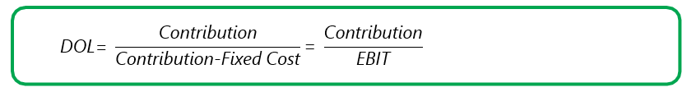
Degree of Operating Leverage (DOL)
DOL measures magnitude of disproportionate change. Degree of Operating Leverage may be defined as percentage change in EBIT with respect to percentage change in sales quantity.

Slide 7

Break-Even Analysis and Operating Leverage
Break-even analysis is a generally used to study the Cost Volume Profit analysis. It is concerned with computing the break-even point.
At this point of production level and sales there will be no profit and loss i.e. total cost is equal to total sales revenue.

Slide 8
Break-Even Analysis and Operating Leverage
Particulars | Product X | Product Y
 | (`) | (`)
Selling Price | 40 | 20
Variable Cost | 20 | 12
Contribution | 20 | 8
Total Contribution of 1,000 units | 20,000 | 8,000
Fixed Cost | 15,000 | 5,000
Profit (EBIT) | 5,000 | 3,000
Break- even point (Fixed Cost / Contribution) | 15,000/20 = 750 units | 5,000/8 = 625 units
Operating Leverage æ Contribution EBIT | 20,000 = 4 5,000 | 8,000 = 2.67 3,000

Slide 9
Conti…
There is a relationship between leverage and Break-even point. Both are used for profit planning. In brief the relationship between leverage,break-even point and fixed cost as under:
Leverage | Break-even point
1. Firm with high leverage | 1. Higher Break-even point
2. Firm with low leverage | 2 .Lower Break-even point

Slide 10


Margin of Safety and Operating Leverage
In cost accounting, one studies that margin of safety (MOS) may be calculated as follows:
Higher margin of safety indicates lower business risk and higher profit and vice versa.

Slide 11


Profit Volume Ratio (PV Ratio)
The Profit Volume (P/V) Ratio is the measurement of the rate of change of profit due to change in volume of sales.
It is one of the important ratios for computing profitability as it indicates contribution earned with respect of sales.

Slide 12

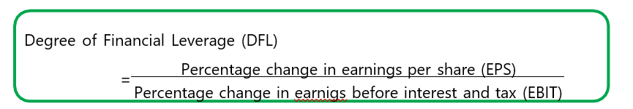
Financial leverage
Financial leverage (FL) maybe defined as ‘the use of funds with a fixed cost in order to increase earnings per share.’ In other words, it is the use of company funds on which it pays a limited return.
Financial leverage involves the use of funds obtained at a fixed cost in the hope of increasing the return to common stockholders.

Slide 13
Financial Leverage as a ‘Double edged Sword’
On one hand when cost of ‘fixed cost fund’ is less than the return on investment financial leverage will help to increase return on equity and EPS.
The firm will also benefit from the saving of tax on interest on debts etc. However, when cost of debt will be more than the return it will affect return of equity and EPS unfavourably and as a result firm can be under financial distress. This is why financial leverage is known as “double edged sword”.
Effect on EPS and ROE:
When, ROI > Interest – Favourable – Advantage When, ROI < Interest – Unfavourable – Disadvantage
When, ROI = Interest – Neutral – Neither advantage nor disadvantage.

Slide 14
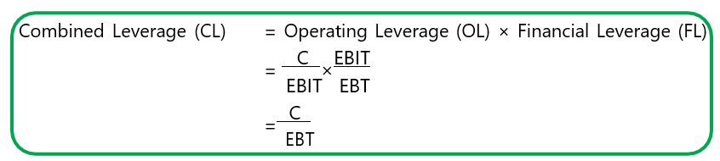
Combined leverage
Combined leverage maybe defined as the potential use of fixed costs, both operating and financial, which magnifies the effect of sales volume change on the earning per share of the firm.

Slide 15

Degree of Combined Leverage (DCL
Degree of combined leverage (DCL) is the ratio of percentage change in earning per share to the percentage change in sales. It indicates the effect the sales changes will have on EPS.

